Slide 1
Shufersal
item substitute system for On-line sales

Slide 2

Agenda
Business Issue
Target value
EDA
Data Preparation & Data Manipulation
Models & Scores
Last stage
Conclusion
Future options

Slide 3
Business Issue
not having sub prod or having bad sub prod, cut sales!
Only one chance to win!
Our data is from Shufersal, On-line sales
Bazzzz

Slide 4
Target value
Will the customer approve? Precision & f1
How good the current replace mechanism?
Recommending the “Best” substitutes - Top 2

Slide 5
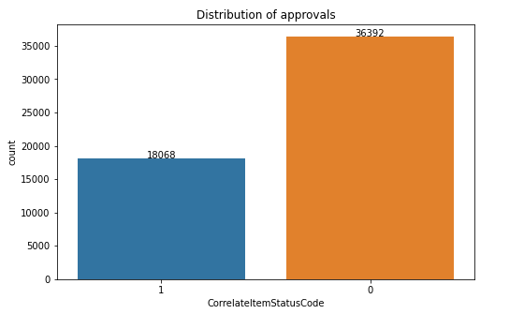
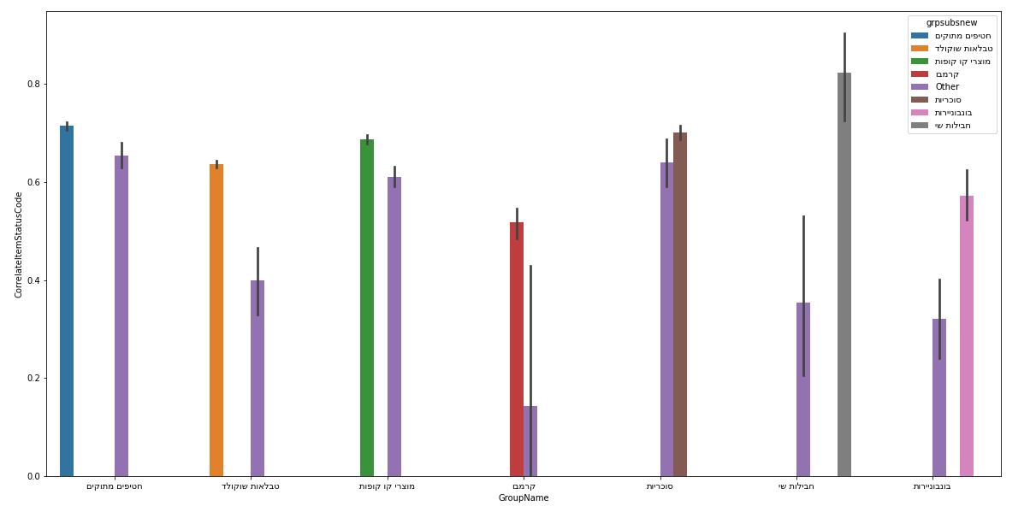
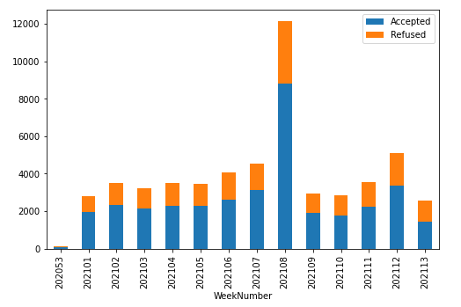
EDA
Data distribution
Distribution over time
Substitute groups

Slide 6
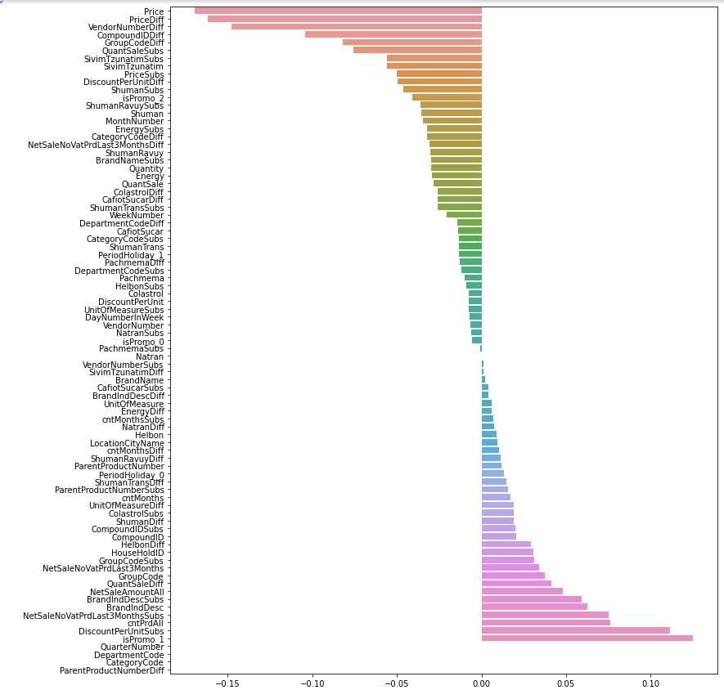

Slide 7
Data Preparation & Data Manipulation — itay
Difffffff varying types
Dummies
product statistics panel by price
Date to period - holiday indication
important info - Promoted products, ingredients

Slide 8
Models & Scores
8 Models
Overfit, validate and stabilize. List of models, table of scores. Ccp, grid . What came up!? - feature importance / diff ? Feature importance….! ROC AUC Voting, cross validation

Slide 9
Models & Scores

Slide 10
Models & Scores

Slide 11
Last stage
predictions - enrichment did not bring the expected value… ?
Cans & Detregents
Predict proba

Slide 12
Conclusion
Model is robust and valid
models over different data, random forest, predict acceptance, mechanism quality, new recommendation based on predict probe

Slide 13
Future options
Model per division over all products tree
clustering
personalization!

